Slide 1
Marine Spatial Planning for Megafauna in a Dynamic Ocean: Methods and Applications
Thesis Proposal Ph.D. Program in Marine Science and Conservation Nicholas School of the Environment Duke University
Benjamin D. Best
March 31 2011

Slide 2
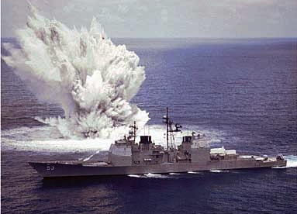
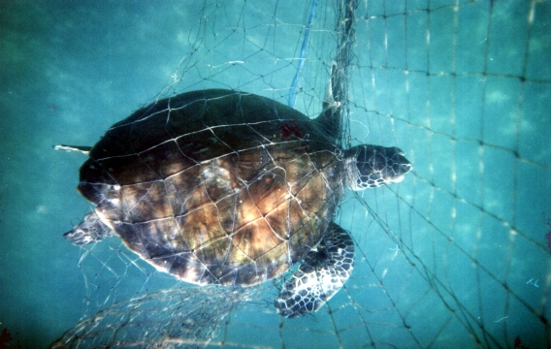
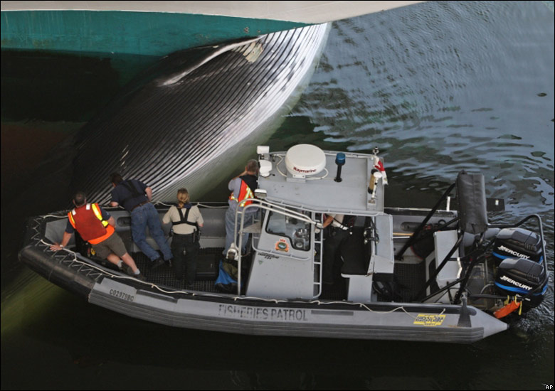
Marine Spatial Planning
Crowder et al, 2006 Science
Notes:
Crowder, L. B., G. Osherenko, O. R. Young, S. Airame, E. A. Norse, N. Baron, J. C. Day, F. Douvere, C. N. Ehler, B. S. Halpern, S. J. Langdon, K. L. McLeod, J. C. Ogden, R. E. Peach, A. A. Rosenberg, and J. A. Wilson. 2006. SUSTAINABILITY: Resolving Mismatches in U.S. Ocean Governance. Science 313:617-618. Retrieved October 1, 2008, .

Slide 3
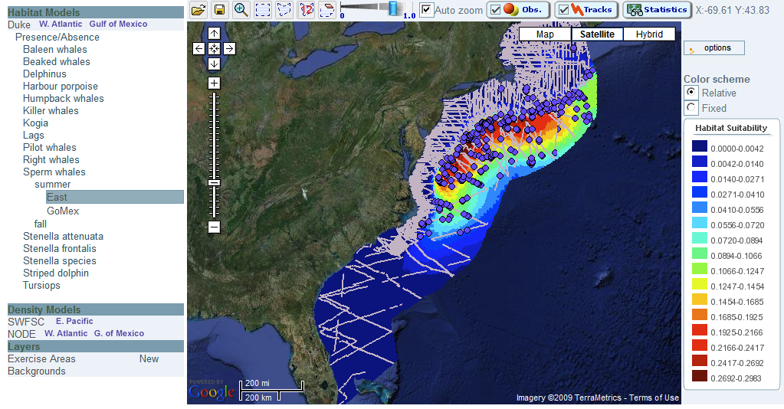
Need SDSS for Megafauna
Who, What, When, Where, How, Why?
Notes:
Who = spp: guilds, assoc, trophic links, aggregated into single layer
( Ok a little anthropamorphizing xharismatic megafauna)
What env associations
beyond usual suspects MLD, eddies
Where space
persistent places, shifts in When
When time (seasons, forecast, climate)
How decision making, using all avail data (multiple platforms, obs portal, expert opinion)
Why Skipping. More of an Evolutionary Q.

Slide 4
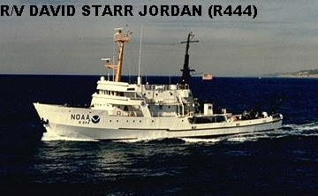
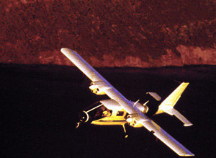
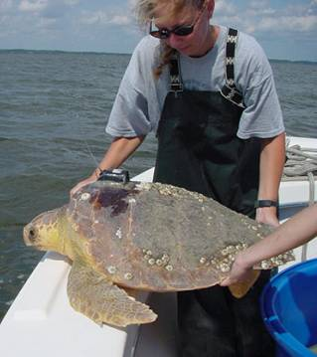

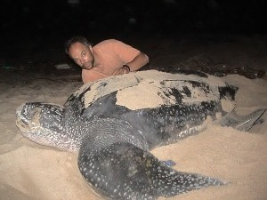
Data from Many Platforms

Slide 5
Chapters: Data Decision
Robust, Dynamic Distribution Models
Predicting Seasonal Migration
Probabilistic Range Maps
Decision Mapping
Conservation Routing
Maximizing Species Distribution Models (SDMs) for Decision-Making: Marine Spatial Planning Methods for Cetacean Conservation
Notes:
Make the most of existing data: fuse data types. Locale of each (US Atlantic) [next time, inset maps for each in upper right corner]
Questions:
Further aspects to study?
MSP or other case studies to draw from?

Slide 6
Chapters
Robust, Dynamic Distribution Models
Predicting Seasonal Migration
Probabilistic Range Maps
Decision Mapping
Conservation Routing
Notes:
Make the most of existing data. Fuse it.
Questions:
Further aspects to study?
MSP or other case studies to draw from?

Slide 7
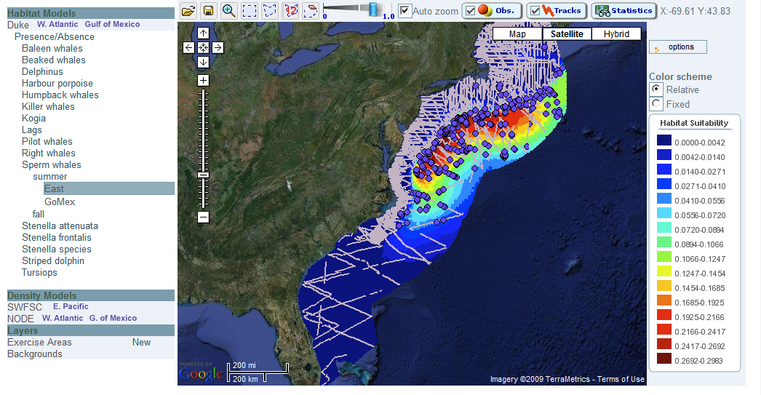
Baseline SDM: Boat + Plane
1. Robust, Dynamic Distribution Models
Best BD, PN Halpin et al (in revision) Online Cetacean Habitat Modeling System for the U.S. East Coast and Gulf of Mexico. ESR.

Slide 8
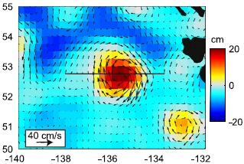
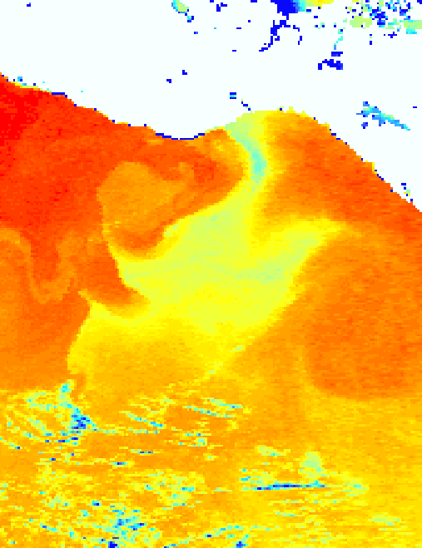
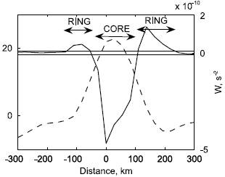
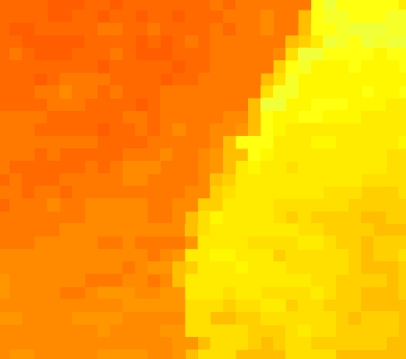
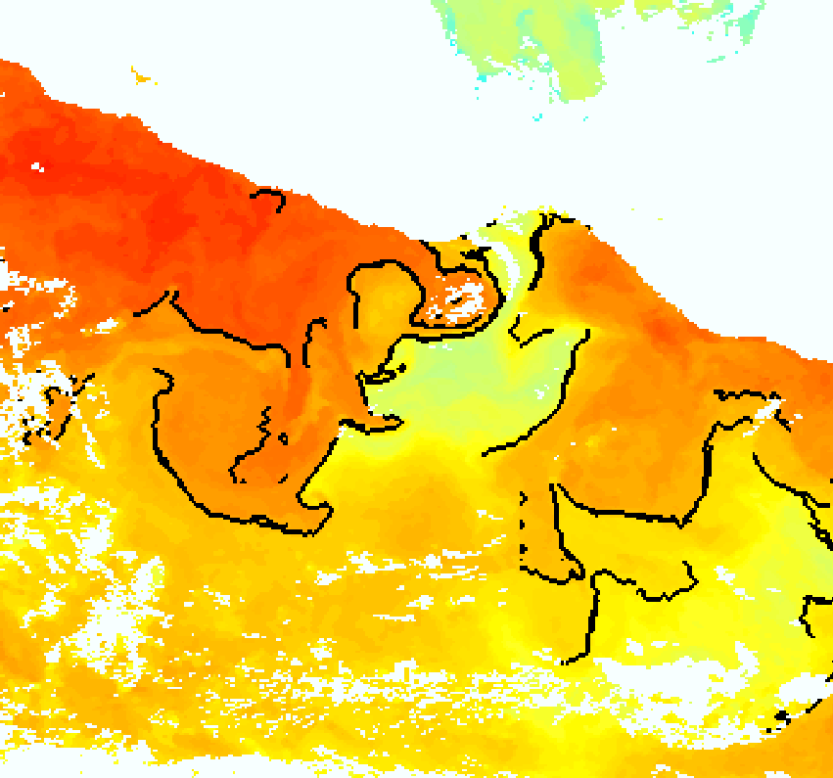
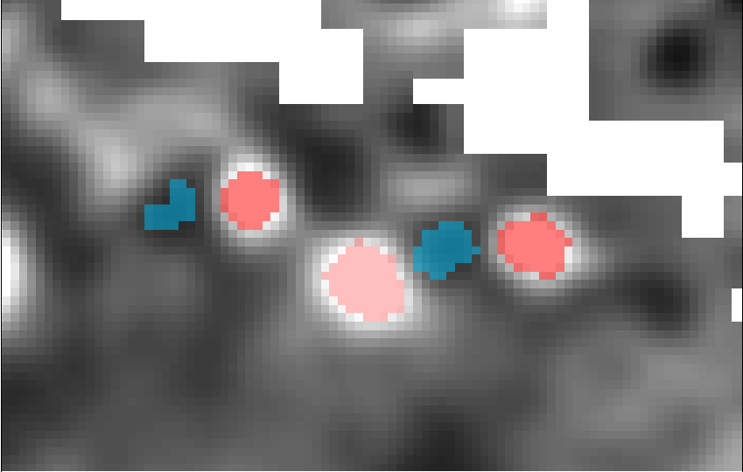
1. Robust, Dynamic Distribution Models
Dynamic Variables from Satellites
Eddies from AVISO
Fronts from Pathfinder / GHRSST
Isern-Fontanet et al (2006)
Cayula, J-F and P Cornillon (1992)
Optimal break 27.0 °C
Frequency
Temperature
28.0 °C
Front
25.8 °C
Red: Anticyclonic Blue: Cyclonic
Notes:
8

Slide 9
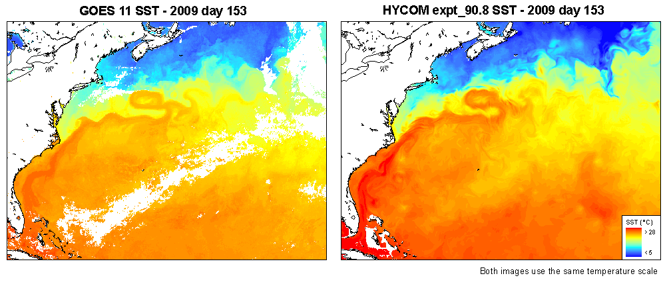
1. Robust, Dynamic Distribution Models
Dynamic Variables from Oceanographic Models
Hybrid Coordinate Ocean Model (HYCOM) pros: 1/12 °, cloud-free, 3D, forecast
cons: modeled, since 2003, physical only
Notes:
9

Slide 10
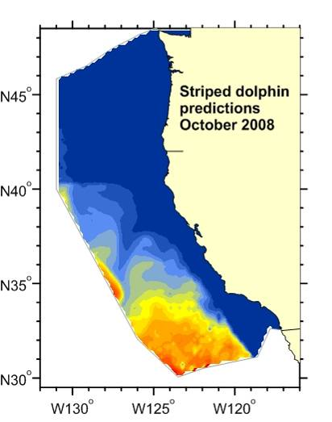
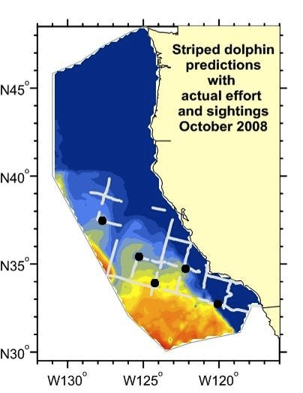
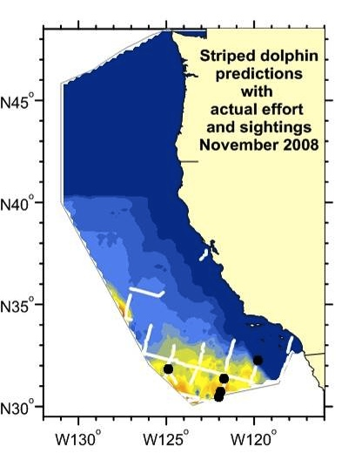
Future: Forecast using ROMS to Oct, Nov (predicting from July)
1. Robust, Dynamic Distribution Models
Becker and Forney (SWFSC)
Notes:
Add survey + obs
Get sense of variability

Slide 11
Robust Comparison
1. Robust, Dynamic Distribution Models
Presence < Presence-Absence < Density?
Regression (GLM, GAM) vs Machine Learning (Maxent, BRT)
Predictive Performance vs Ecological Interpretation
Space Time Lags
Scaling Effects

Slide 12
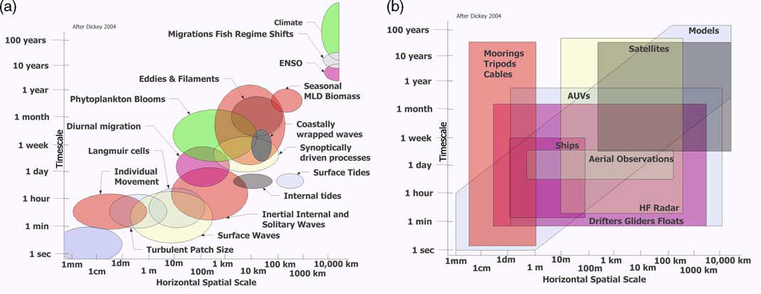
Oceanographic Space Time
1. Robust, Dynamic Distribution Models
Processes
Observations
From Hill et al. (2010) after Stommel (1963) and Dickey (2004)
Notes:
(after Stommel, 1963 and Dickey, 2004)
Hill, K., T. Moltmann, R. Proctor, and S. Allen. 2010. The Australian Integrated Marine Observing System: Delivering Data Streams to Address National and International Research Priorities. Marine Technology Society Journal 44:65–72.
Animal Space Time

Slide 13
Chapters
Robust, Dynamic Distribution Models
Predicting Seasonal Migration
Probabilistic Range Maps
Decision Mapping
Conservation Routing
Notes:
Make the most of existing data. Fuse it.
Questions:
Further aspects to study?
MSP or other case studies to draw from?

Slide 14
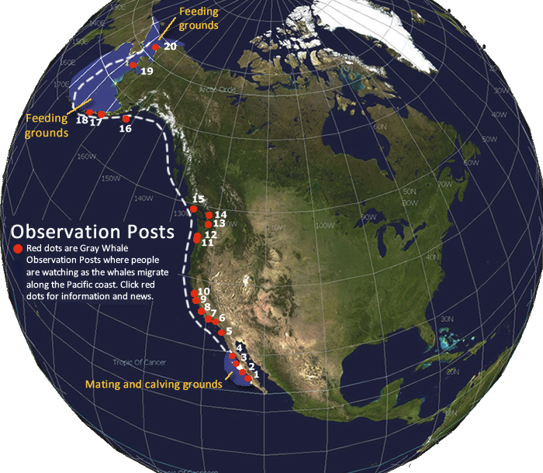
Grey Whale Migration
2. Predicting Seasonal Migration
Notes:
Eastern North Pacific gray whales make a mammoth 20,000 km (12,400 mile) round trip between their southern breeding grounds off Baja California, Mexico and their northern feeding grounds off Alaska and the Beaufort Sea.
April - November: Arctic feeding grounds [October - February: migrates south] December - April: Mexican breeding grounds [February - July: migrates north]
In the early winter, they move south to breed in the warm, shallow lagoons along the Mexican coast. The most popular breeding lagoons are San Ignacio lagoon, Scammon's lagoon, and Magdalena Bay, on the Pacific coast of Baja California, Mexico. Around February, the grays migrate north to feed in Arctic waters (western Beaufort Sea and Bering Sea), northwest of Alaska. A few - mainly younger - whales make a shorter journey north from Mexico, stopping off along the coastline stretching between northern California, Oregon, Washington State, USA, and British Columbia, Canada. Some feeding behaviour has been observed in all parts of the range, and around Vancouver Island, British Columbia, Canada, grays are present year-round.

Slide 15
Simple T-S Migration Model
2. Predicting Seasonal Migration
GAM y ~ s(x,t) + …
GAM y ~ s(x,t) + s(w,t) +…
Summer Feeding
GLM: y ~ x:t + …
1.5
30
x (1000 km)
1
W ( km)
20
0.5
10
Winter Calving
Jan
Feb
Mar
Jan
Feb
Mar
t
t
Notes:
mid: laggards leaving. End: over-acheivers.

Slide 16
Chapters
Robust, Dynamic Distribution Models
Predicting Seasonal Migration
Probabilistic Range Maps
Decision Mapping
Conservation Routing
Notes:
Make the most of existing data. Fuse it.
Questions:
Further aspects to study?
MSP or other case studies to draw from?

Slide 17
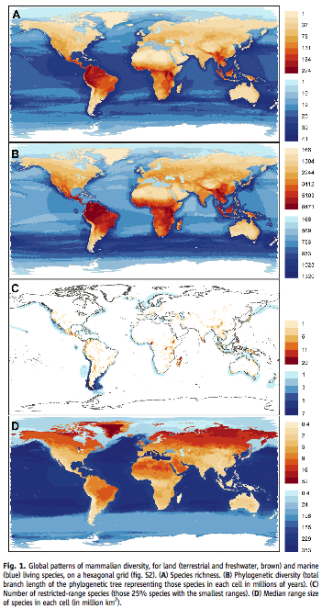

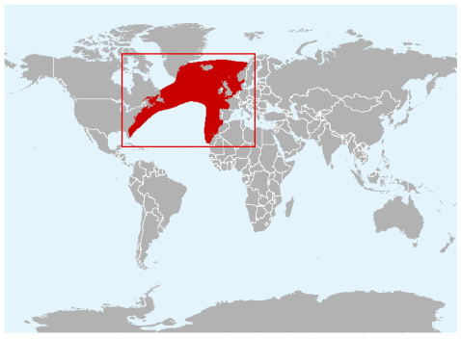
Business as Usual
3. Probabilistic Range Maps
Species richness
Phylogenetic diversity
# Restricted range size
Eubalaena glacialis
expert-convened range maps of species
attributes of species (eg phylogenetic diversity)
Schipper et al (2008) The Status of the World's Land and Marine Mammals: Diversity, Threat, and Knowledge. Science.
Median range size

Slide 18
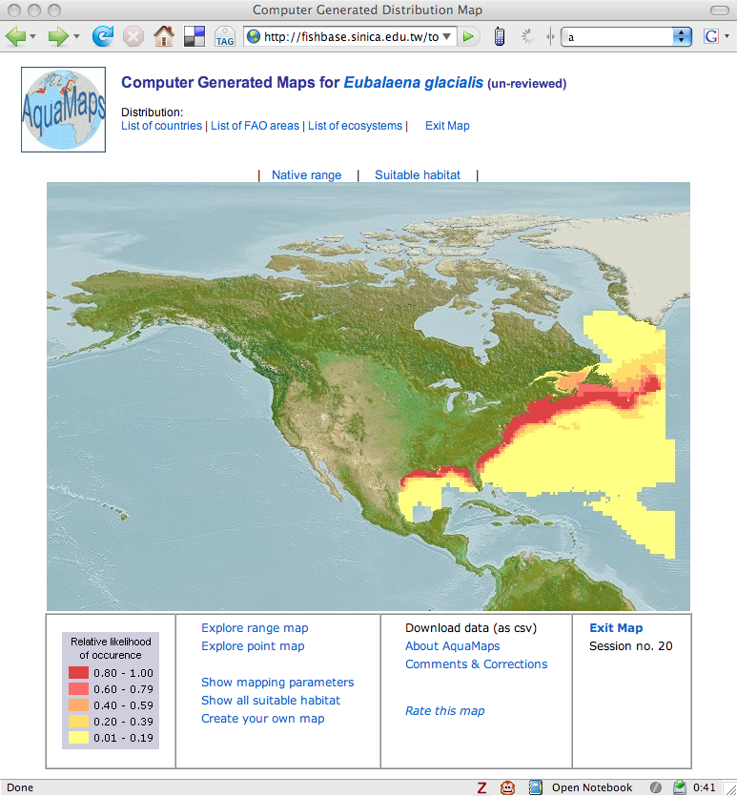
AquaMaps (no probabilities) http://www.aquamaps.org
3. Probabilistic Range Maps
Kaschner, K., et al (2006). Mapping world-wide distributions of marine mammal species using a relative environmental suitability (RES) model. MEPS.
Environmental envelopes are constructed from occurrence data and modified by parameters from literature, including limits of their geographic extent and areas of exclusion.
Environment: depth, SST, salinity, Chl, distance from shore, distance from ice edge.
Status (10/2008): Standardized distribution maps for 9,000 species of fishes, marine mammals and invertebrates
Ready JS, K Kaschner, et al. (2010) Predicting the distributions of marine organisms at the global scale. Ecological Modelling.

Slide 19
Probabilistic Range Maps Example: Northern Right Whale
3. Probabilistic Range Maps
Bayesian State Space Model to
Combine Inputs
Observations from GBIF occurrences
Range Map from IUCN Experts
Effort from all Order Cetacea in GBIF
Relate Inputs to Environment
SST
Depth
Distance to Shore
Output
Probabilistic Range Map
SST
Occurences
Depth
Range Map
Dist to Shore
“Effort” (Cetaceans)
S Loarie, BD Best, J Clark, PN Halpin

Slide 20
Chapters
Robust, Dynamic Distribution Models
Predicting Seasonal Migration
Probabilistic Range Maps
Decision Mapping
Conservation Routing
Notes:
Make the most of existing data. Fuse it.
Questions:
Further aspects to study?
MSP or other case studies to draw from?

Slide 21
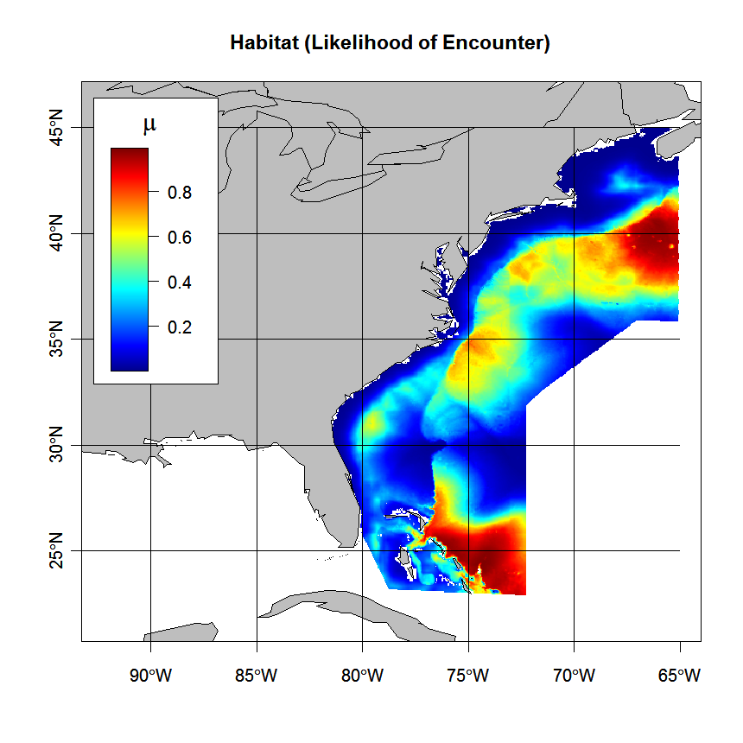
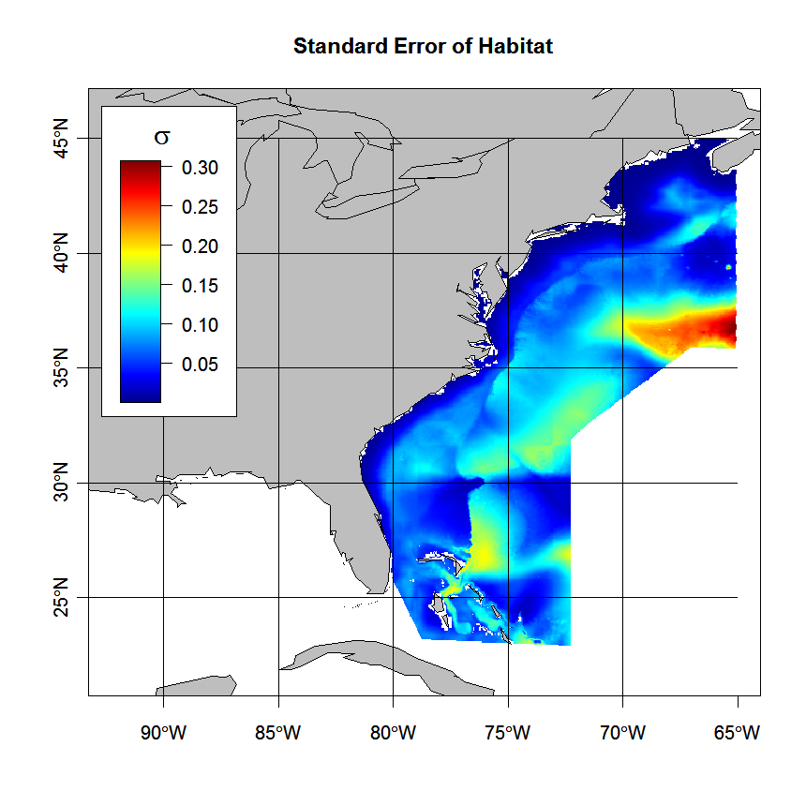
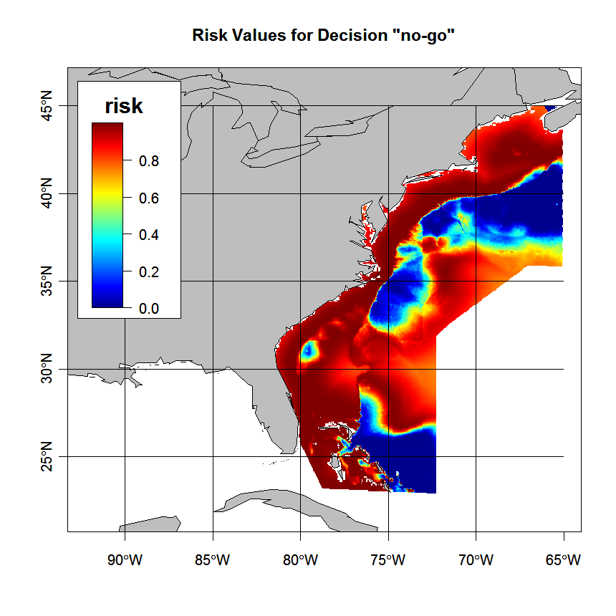
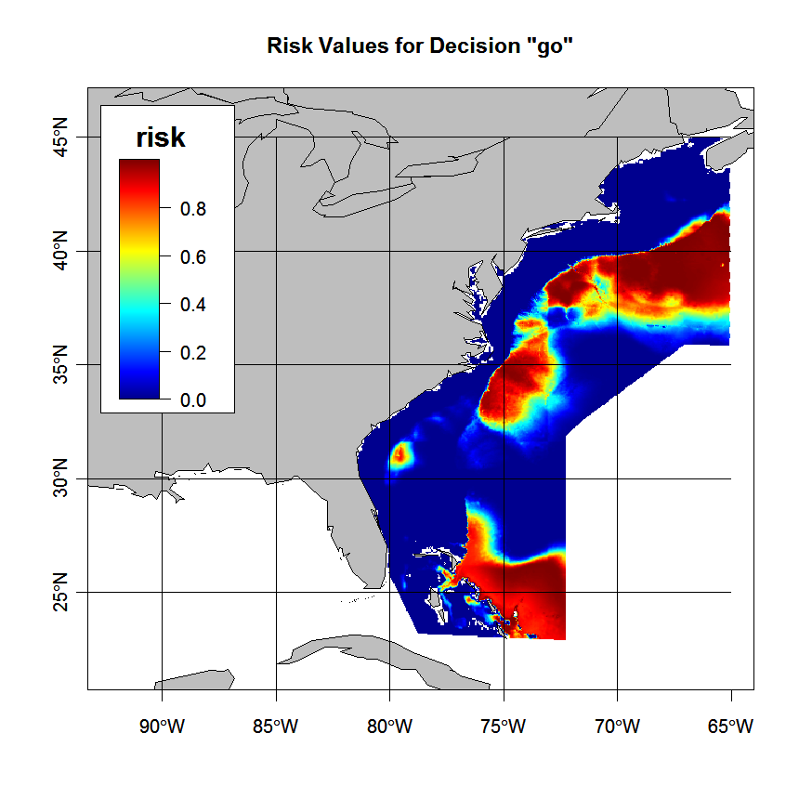
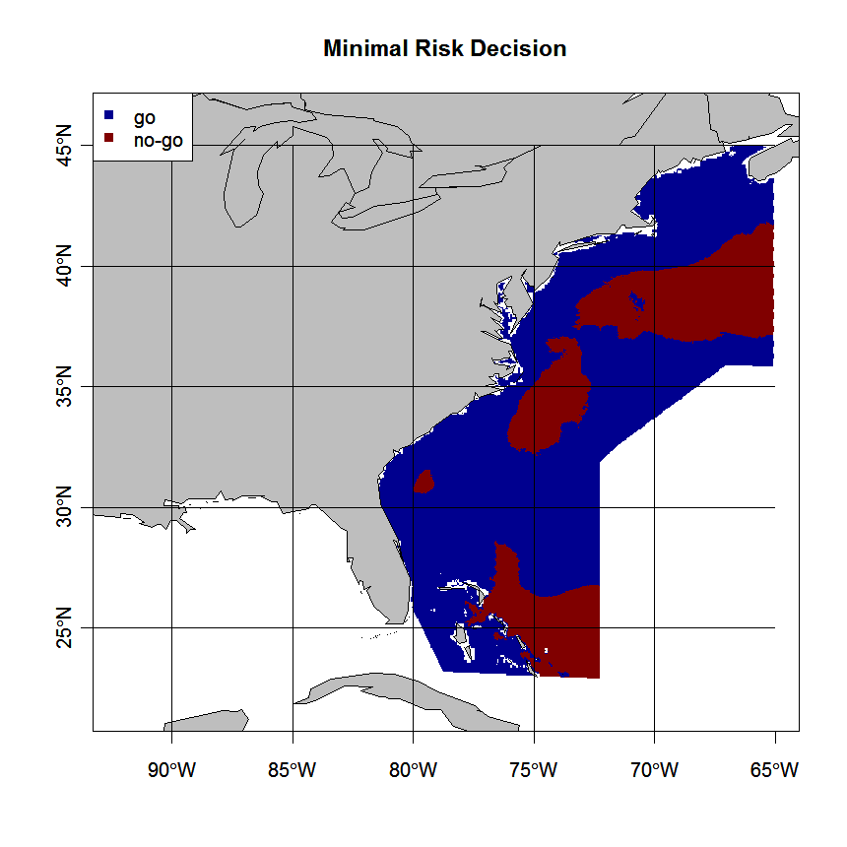
Decision Mapping
4. Decision Mapping
Risk / Loss / Utility Function
Notes:
Example output from applying a loss function (table in upper right) which multiplies the probability of encounter (a) incorporating uncertainty (b) to produce loss maps per decision loss rule (c, d), yielding a map of decisions that minimize loss (e).

Slide 22
Chapters
Robust, Dynamic Distribution Models
Predicting Seasonal Migration
Probabilistic Range Maps
Decision Mapping
Conservation Routing
Notes:
Make the most of existing data. Fuse it.
Questions:
Further aspects to study?
MSP or other case studies to draw from?

Slide 23
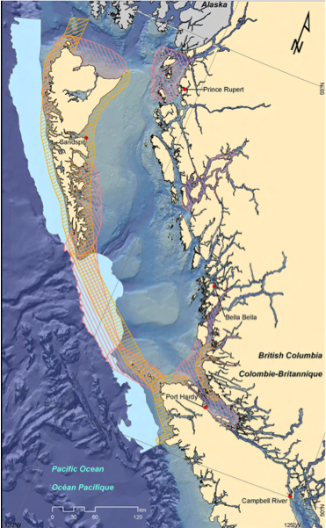
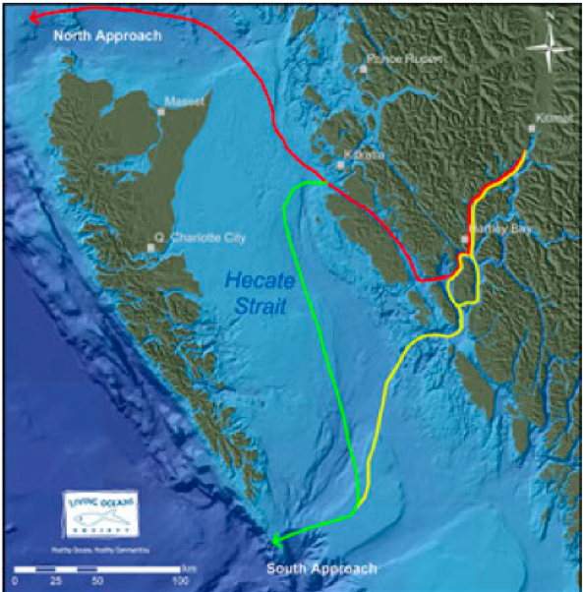
Vessel Routes
5. Conservation Routing
Expert opinion areas for gray, humpback, and sperm whales (PNCIMA Atlas, 2009).
Proposed oil tanker vessel route for servicing the forthcoming Kitimat oil and gas project.

Slide 24
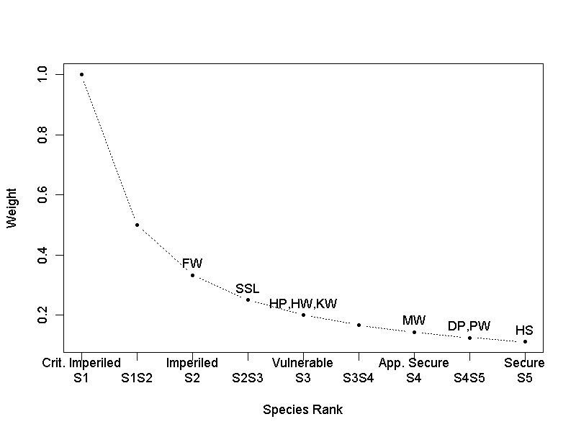
Relative Density
5. Conservation Routing
9 marine mammal species in BC
predictions from env’tal GAM
surveys 2004-2008
summed relative density (z-score), weighted by conservation status (1/r)
(Best et al, in prep)

Slide 25
Least Cost Paths
5. Conservation Routing
Oil Tanker Routes
Cruise Ship Routes
Proposed, linear (Euclidean), and least-cost routes for Kitimat tanker traffic. The least-cost route uses the conservation weighted cost surface.

Slide 26
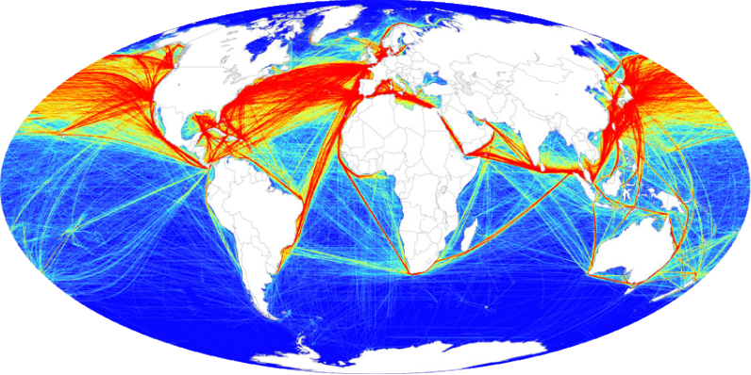
Further Application
5. Conservation Routing
Global Vessel Traffic
Source: Halpern et al (2008) A Global Map of Human Impact on Marine Ecosystems. Science.
Source: Ward-Geiger et al (2005) Characterization of Ship Traffic in Right Whale Critical Habitat. Coastal Management.

Slide 27
Thank You
Let’s chat ☺

Slide 28
BACKUP SLIDES

Slide 29
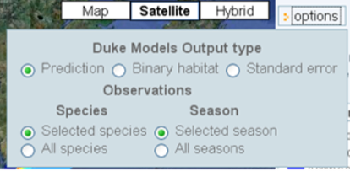
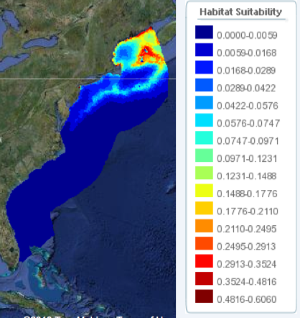
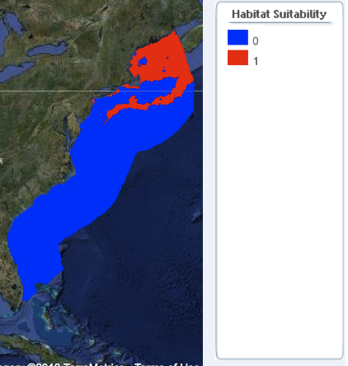
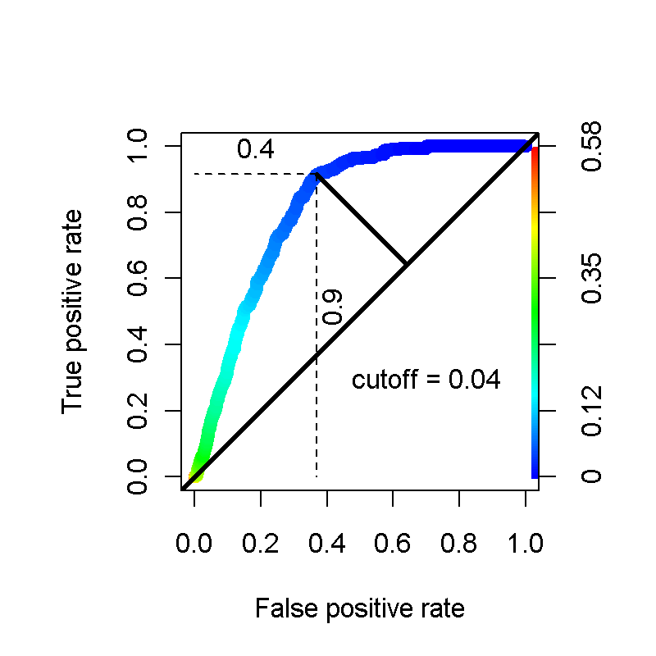
ROC as Corollary to Decision Mapping?
Example: baleen guild (fin, blue, sei, Bryde’s) in summer
Notes:
29

Slide 30
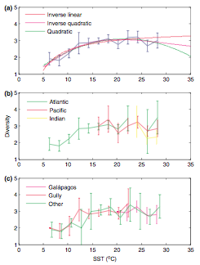
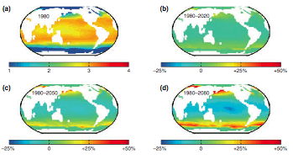
Climate Change Projection
Whitehead, McGill, Worm. 2008. Diversity of deep-water cetaceans in relation to temperature: implications for ocean warming. Ecology Letters

Slide 31
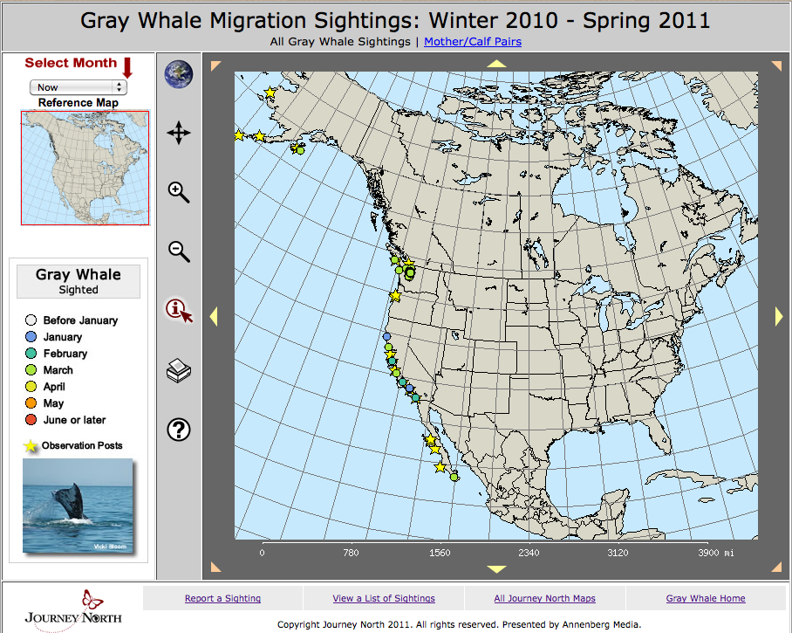

Slide 32
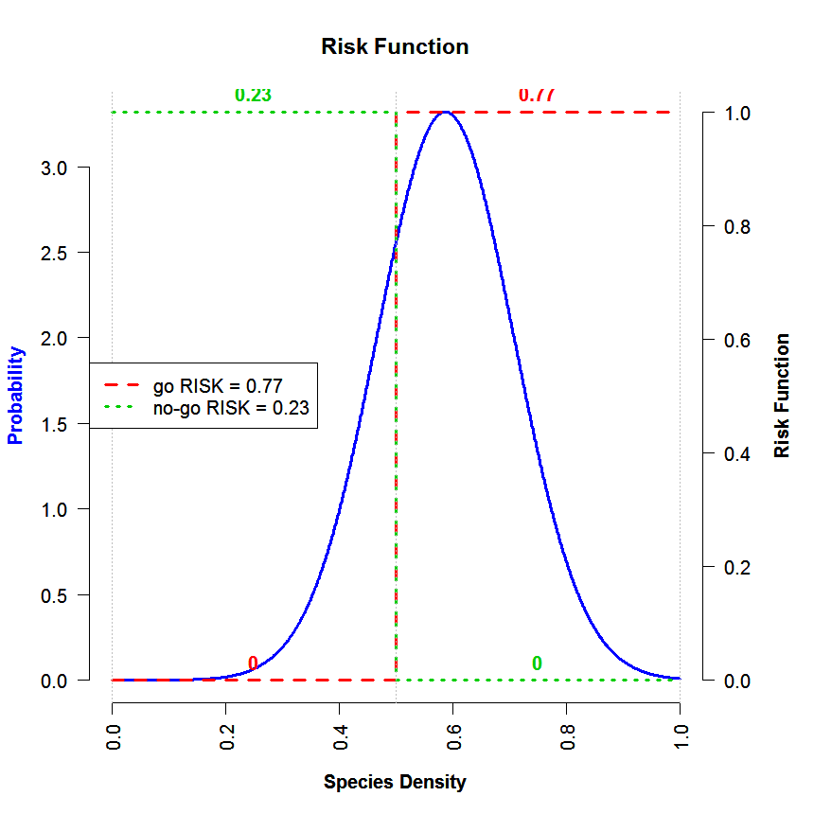
Decision Mapping
Loss Decision
 |  | Integrated Prob(Encounter)
 |  | 0-.5 | .5 to 1
Decision | Go | 0 | 3
 | No-go | 1 | 0
Notes:
Make a decisions spatially based on simple rules which incorporate uncertainty. A given predictive map (a) has uncertainty (b) about its mean values. By integrating the area under the curve on a per pixel basis (d) and applying a decision rule (table), the minimal risk decision can be mapped onto space (c).

Slide 33
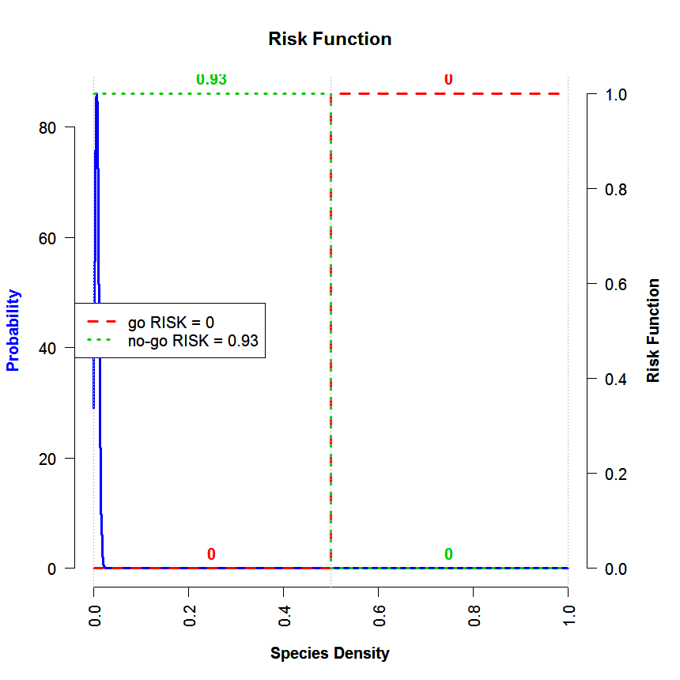
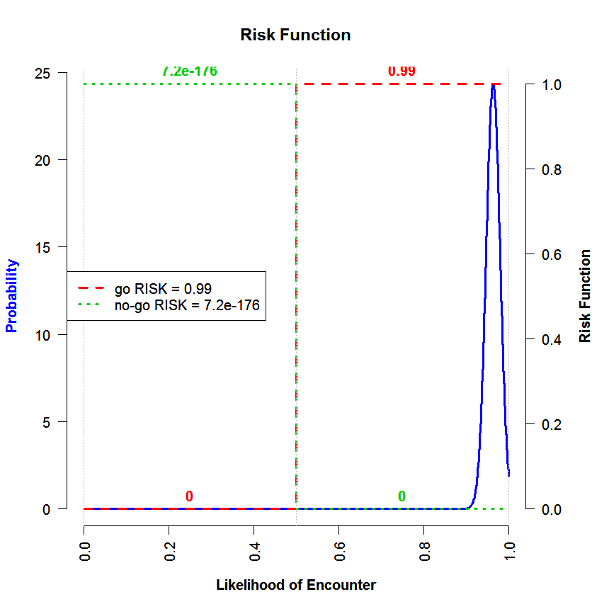
Loss Function
Input Table
(a)
0 | 0.5 | 1
go | 0 | 1
no-go | 1 | 0
(b)
(c)

Slide 34
Further Study
Niche Modeling
Cetacean Ecology
Decision Theory
Operations Research
Environmental Economics

